Slide 1

Collaborative writing
For disabled people

Slide 2
Agenda
Introduction
What?
Why?
Methodology
technology
Demo
conclusions

Slide 3

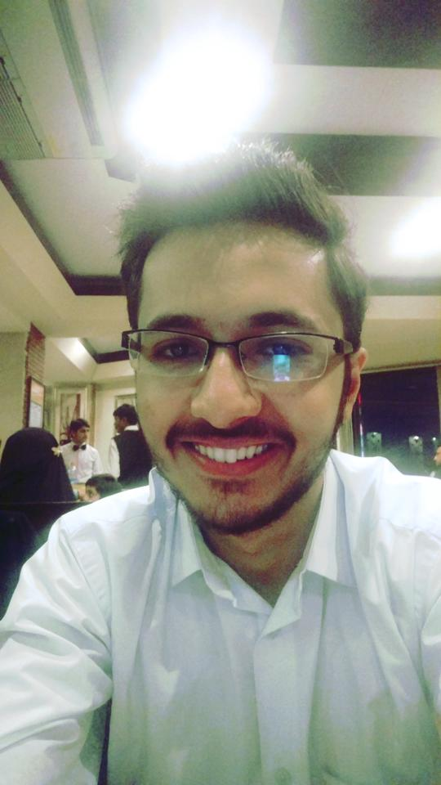
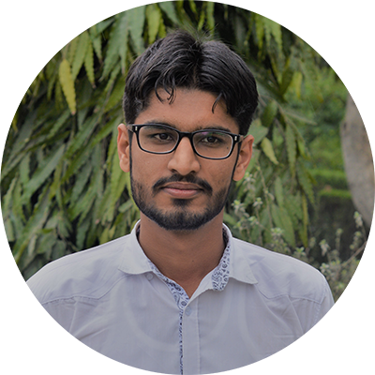
Team Introduction
MUHAMMAD ADNAN | ABDULLAH NASIR | ATTA UR REHMAN
2015-CS-51 | 2015-CS-56 | 2015-CS-61

Slide 4
What is collaborative writing?
Single Document
Multiple people
Location (same or different)

Slide 5
Y?
Estimated 150 Million people around world suffer with disabilities
15% of world population
Their needs , their rights
Effect on Economy
Enable them to contribute

Slide 6
Methodology
Collaborative writing platform
Voice controlled
Text to speech
Voice Commands
Firepad
Collaborative Writing Platform
Annyang.js
Speak.js

Slide 7
Technologies
HTTP Server
Firebase(database of firepad)
Javascript( Annyang.js, SpeechKit, speak.js, Firepad.js)
Html
Css
Chrome (Only chromium based browsers supported)

Slide 8
Live demo

Slide 9
Conclusions and future work
improvements with more precisions
Addition of many commands and functionality
Can be used for educating the disabled
Can be use in mathematical expressions writing
Designing by voice commands

Slide 10
Thanks for being amazing audience

Slide 11
Questions?

